Slide 1
UNIT 9 ALU
Presented by
Er.Harendra Bikram Shah
(Lecturer)

Slide 2
OUTLINES
Introduction
ALU and its Design
status Register
Shifter
Processor Unit
Accumulator

Slide 3
ALU and Its Design
An arithmetic logic unit (ALU) is a major component of the central processing unit of a computer system that does all arithmetic and logic operations that need to be done on instruction.
This unit consists of two subsections namely, Arithmetic Section and Logic Section
Arithmetic Section
Function of arithmetic section is to perform arithmetic operations like addition, subtraction, multiplication, and division. All complex operations are done by making repetitive use of the above operations.
Logic Section
Function of logic section is to perform logic operations such as comparing, selecting, matching, and merging of data.

Slide 4
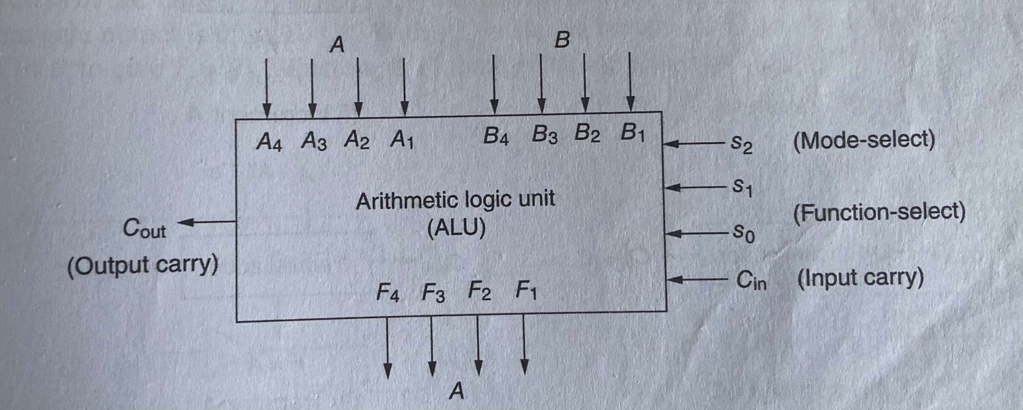
Fig: Block Diagram of 4-bit ALU
The above figure shows the block diagram of 4-bit ALU.
The four data inputs from A are combined with the four inputs of B to generate the operation at the F outputs.
The mode select input s2 distinguishes between arithmetic or logical operations at the F outputs.
The two function – select S1,S0 specify the particular arithmetic or logical operation to be generated.
With three variables selection variables it is possible to specify four arithmetic operation(with S2 in one state ) and a four logic operations(S2 in other state).
The input output carries have meaning only during an arithmetic operation
In this way there are 8 arithmetic operations are generated .

Slide 5
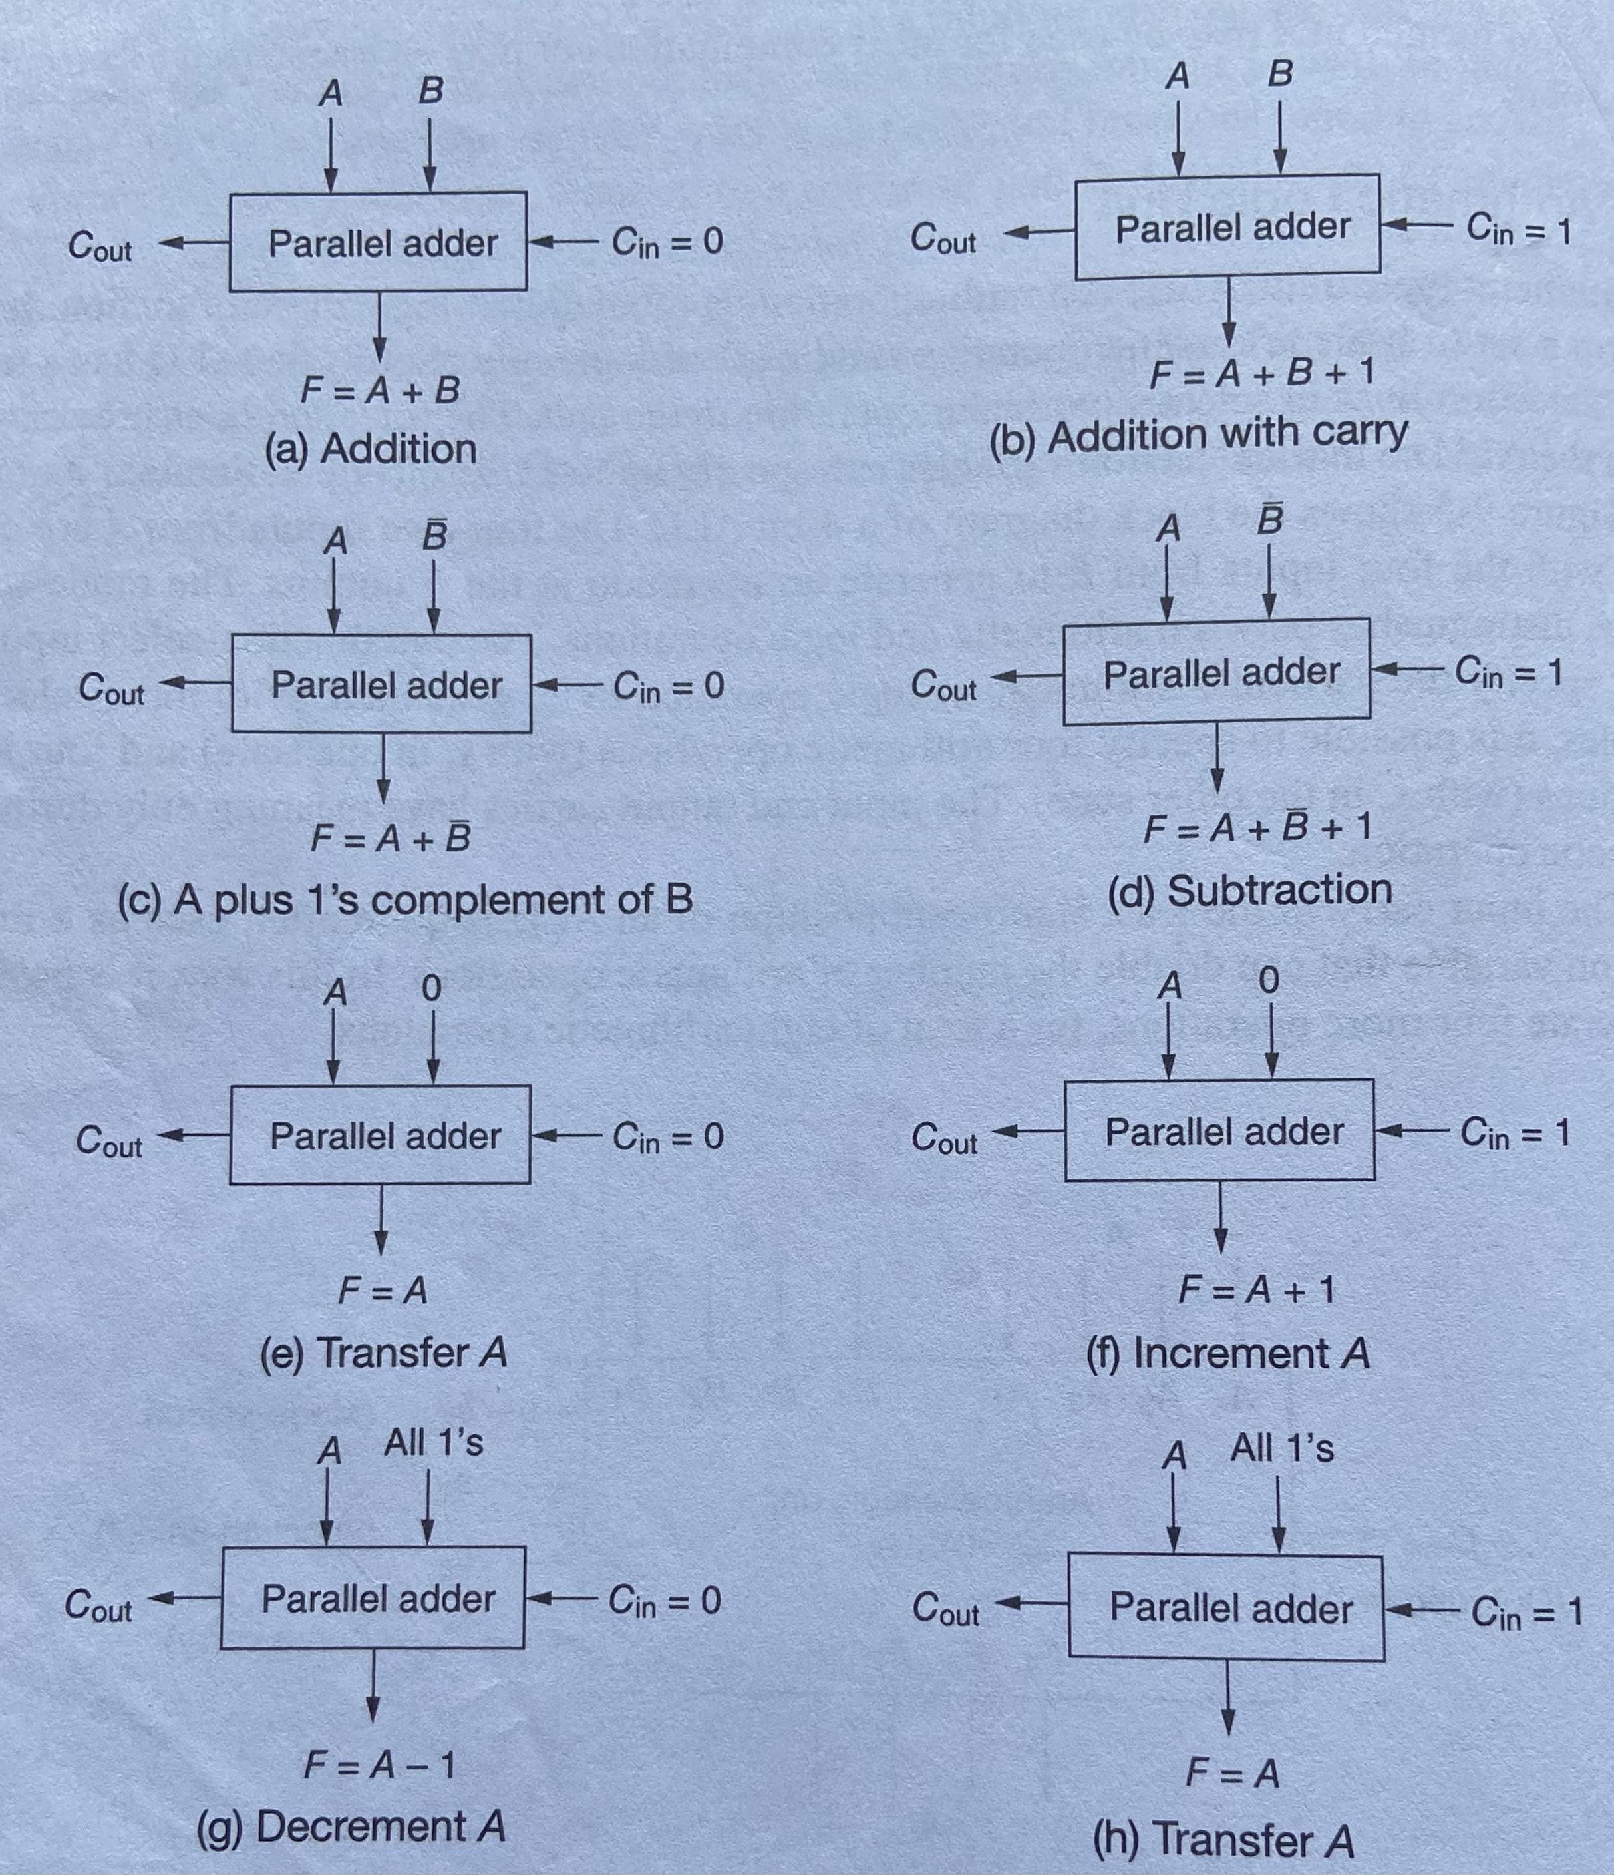
Design of Arithmetic Circuit operation
The following figure demonstrate the 8 arithmetic operations

Slide 6
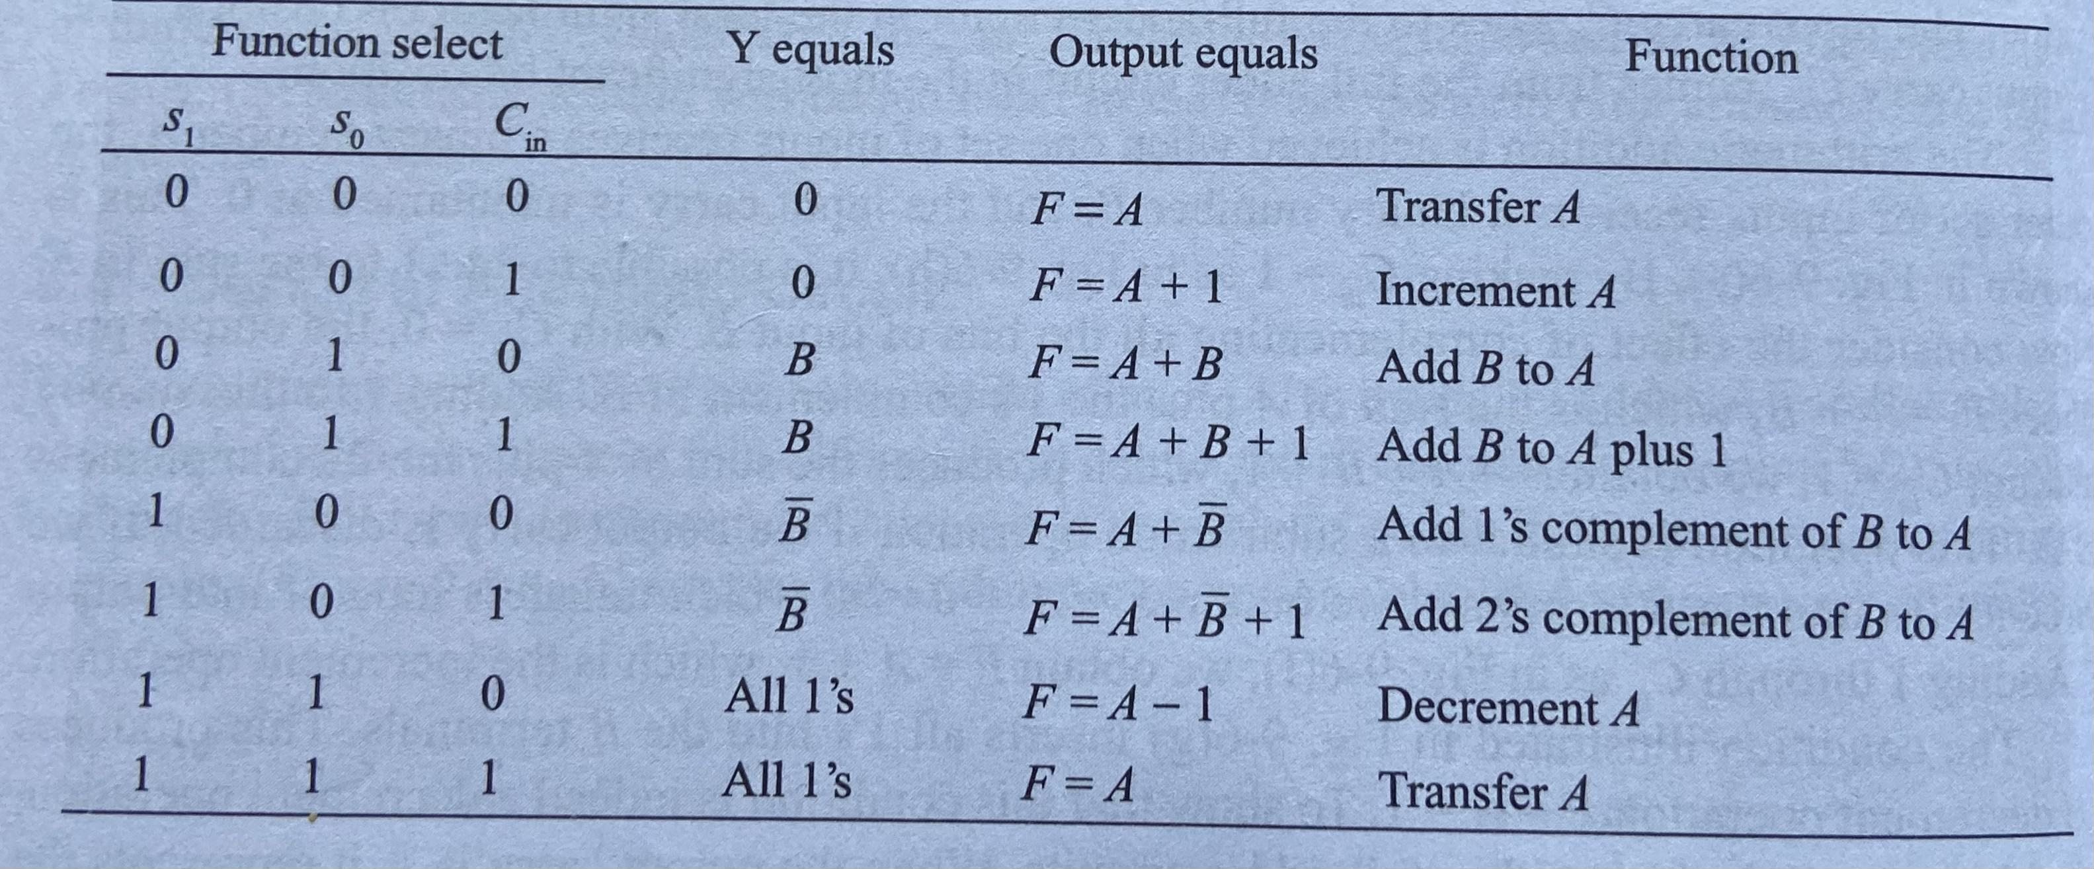
Function Table of Arithmetic Circuit

Slide 7
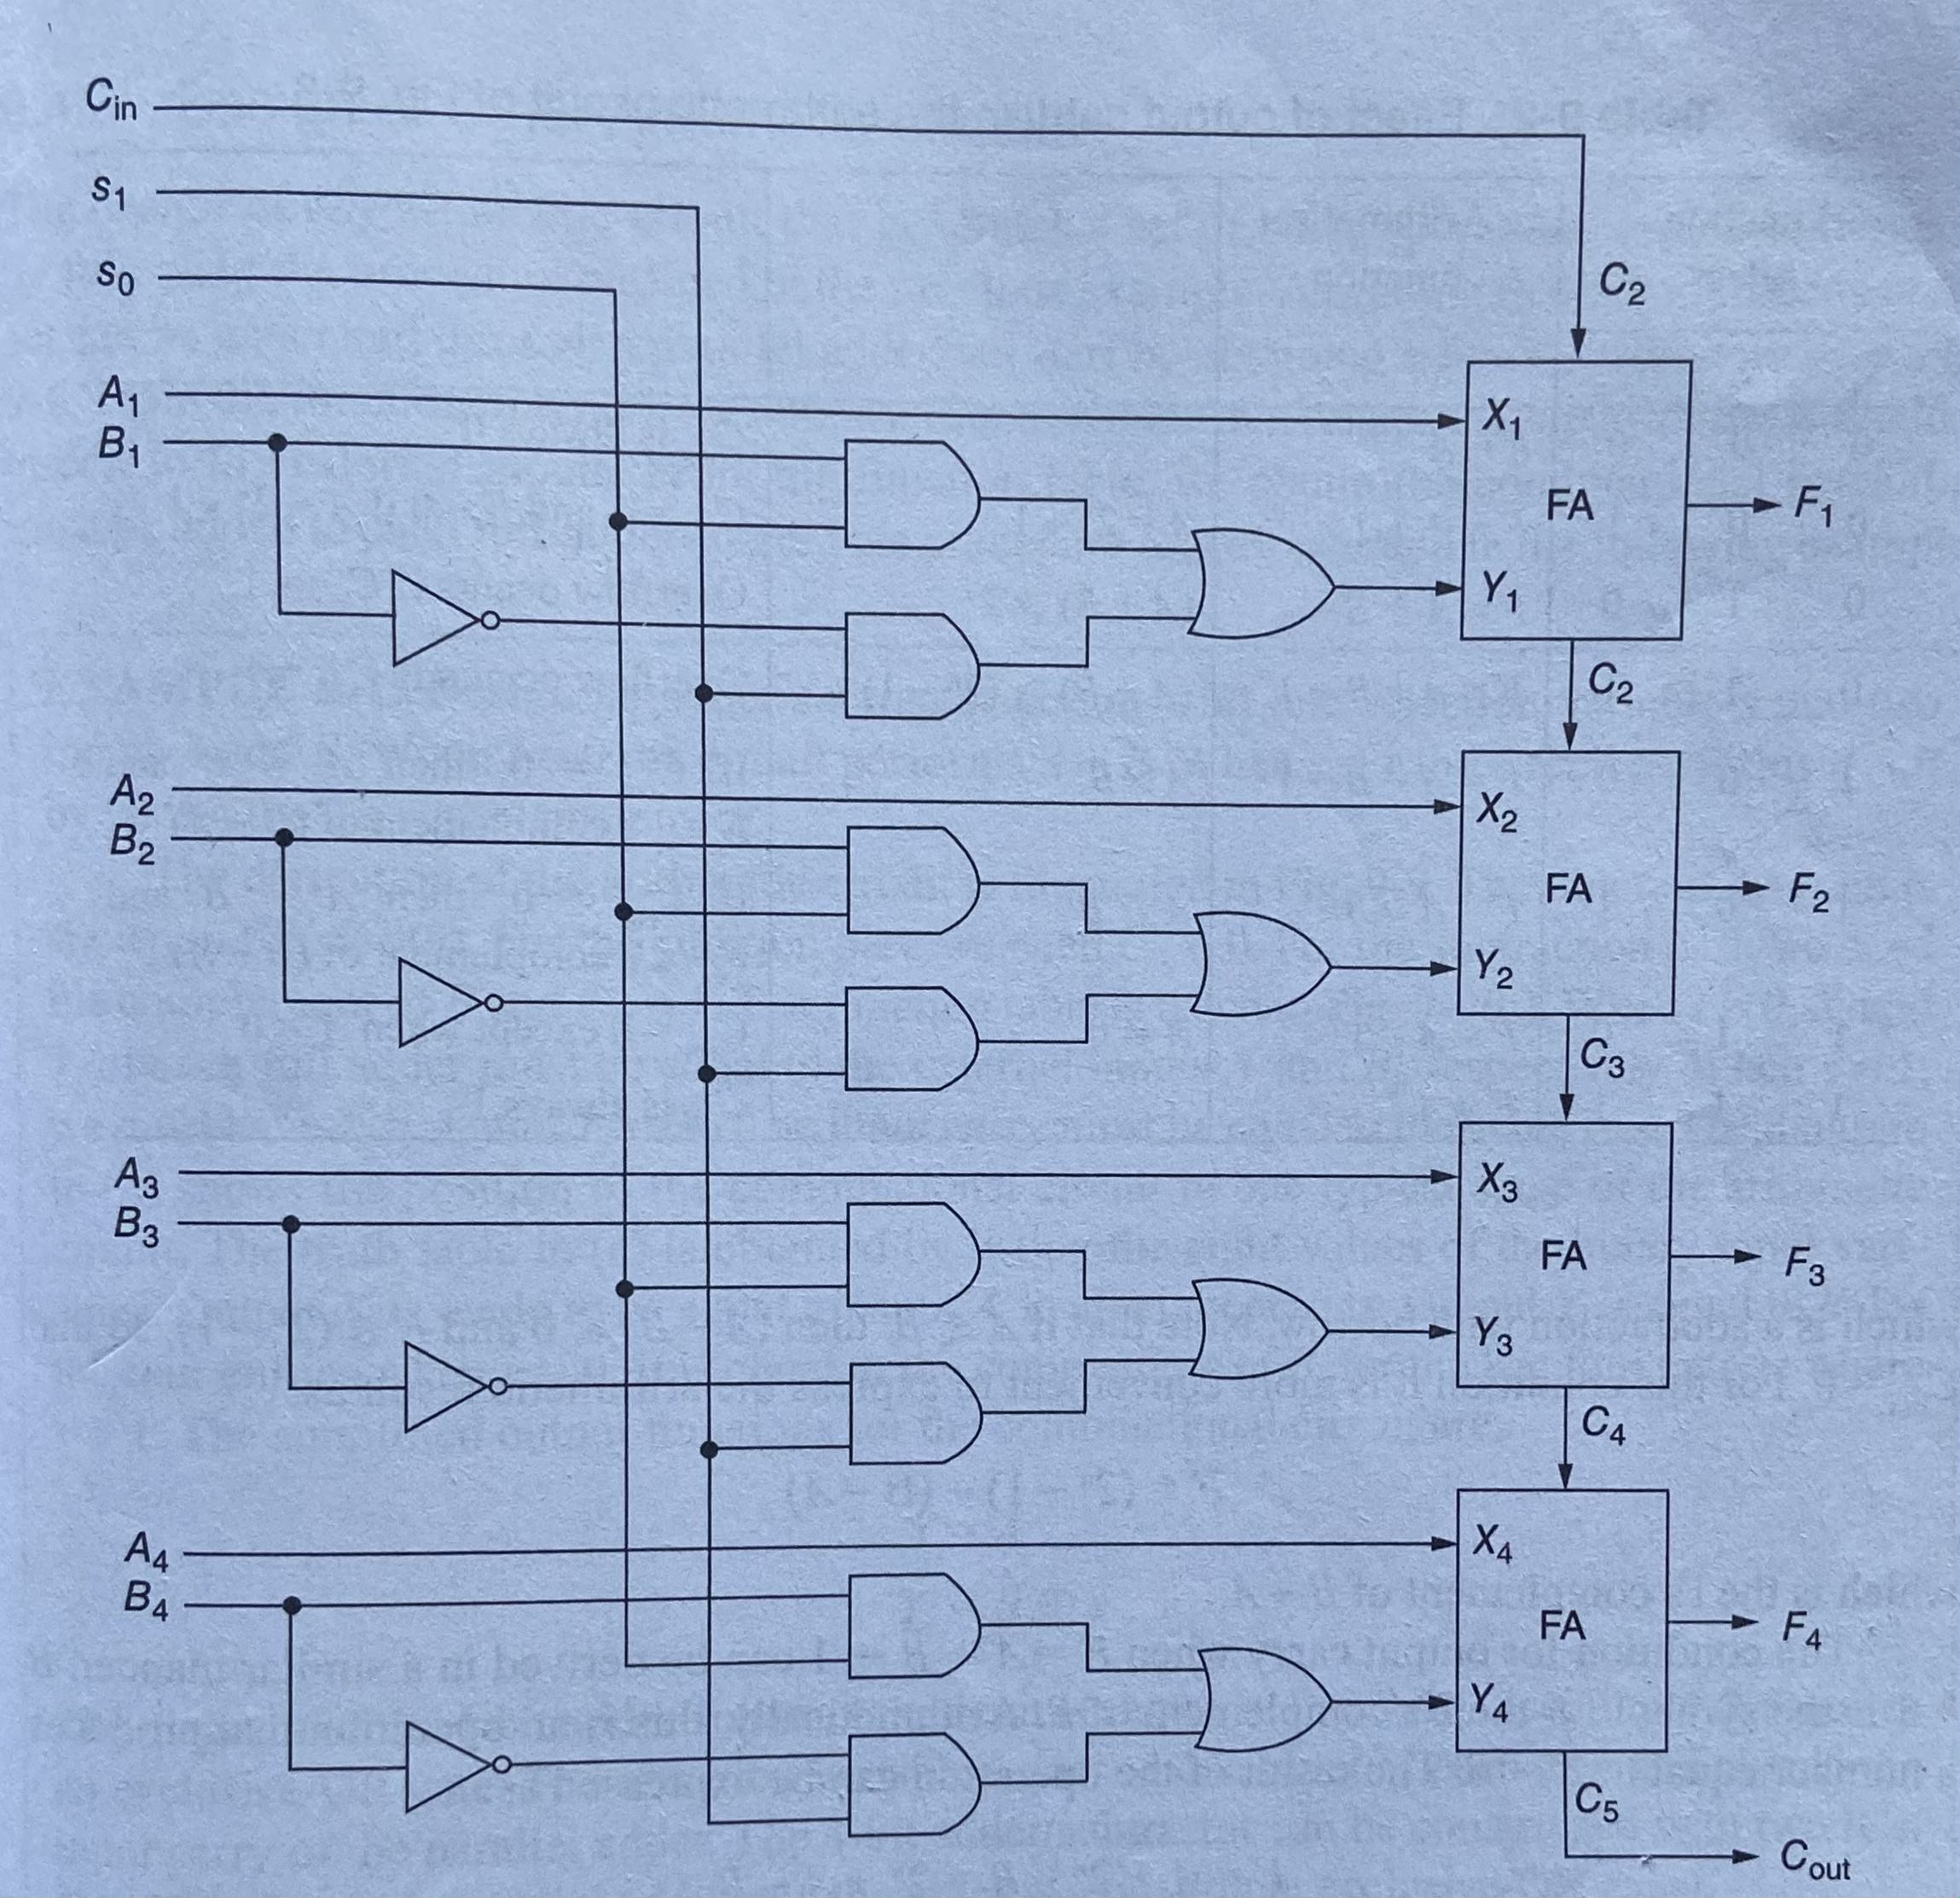
Logic Diagram of Arithmetic Circuit

Slide 8
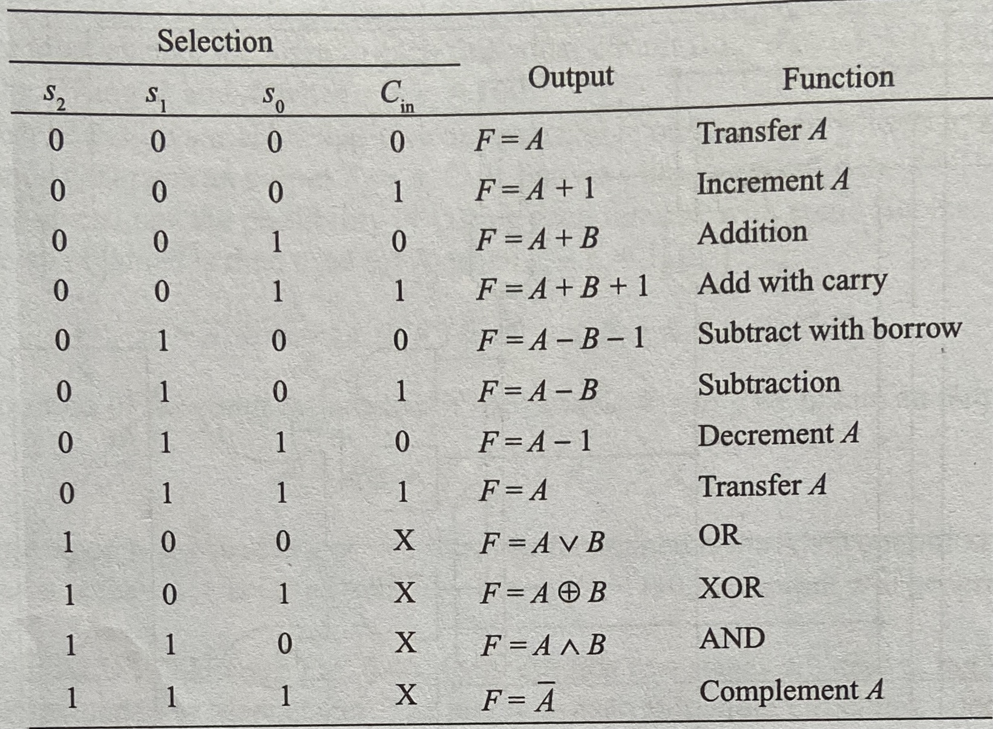
Functional Table of ALU

Slide 9
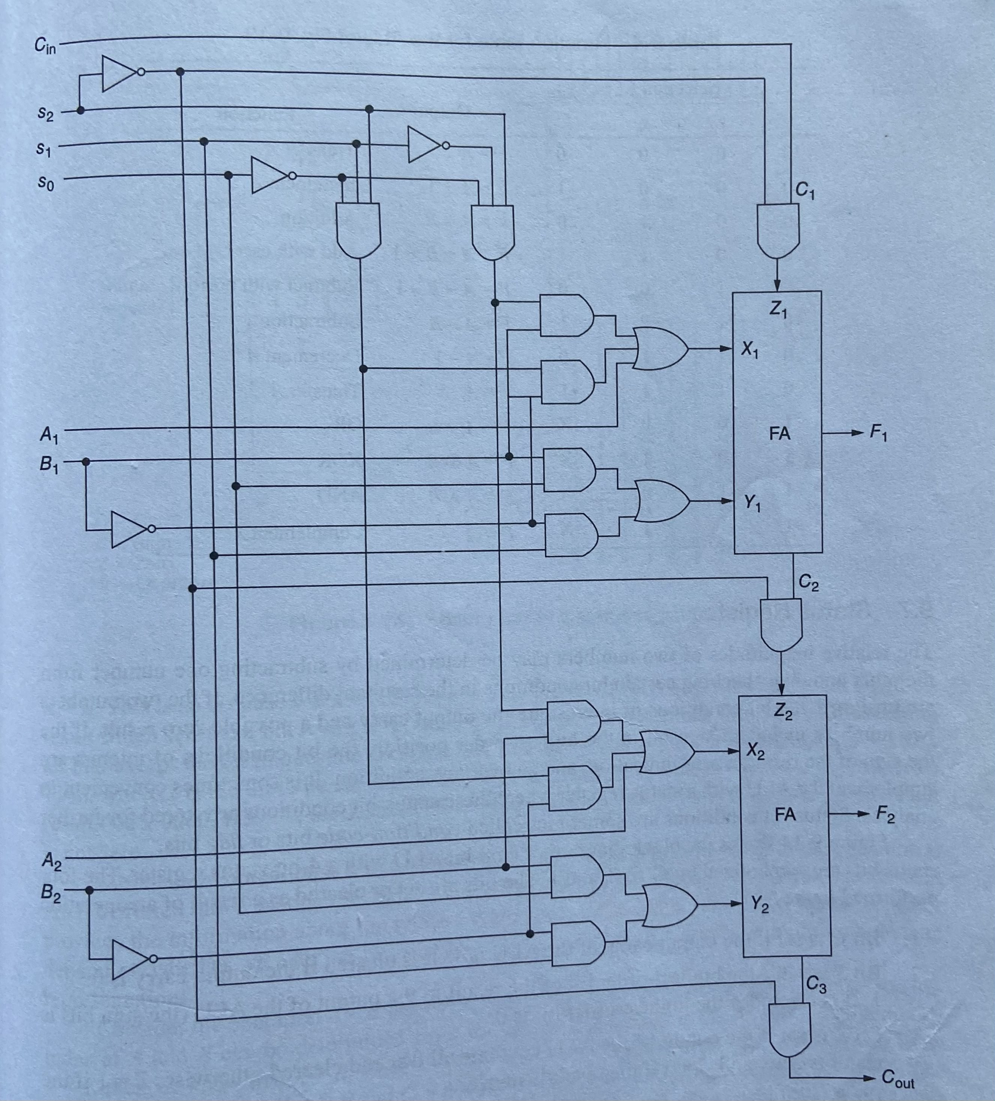
Logic Diagram of ALU

Slide 10
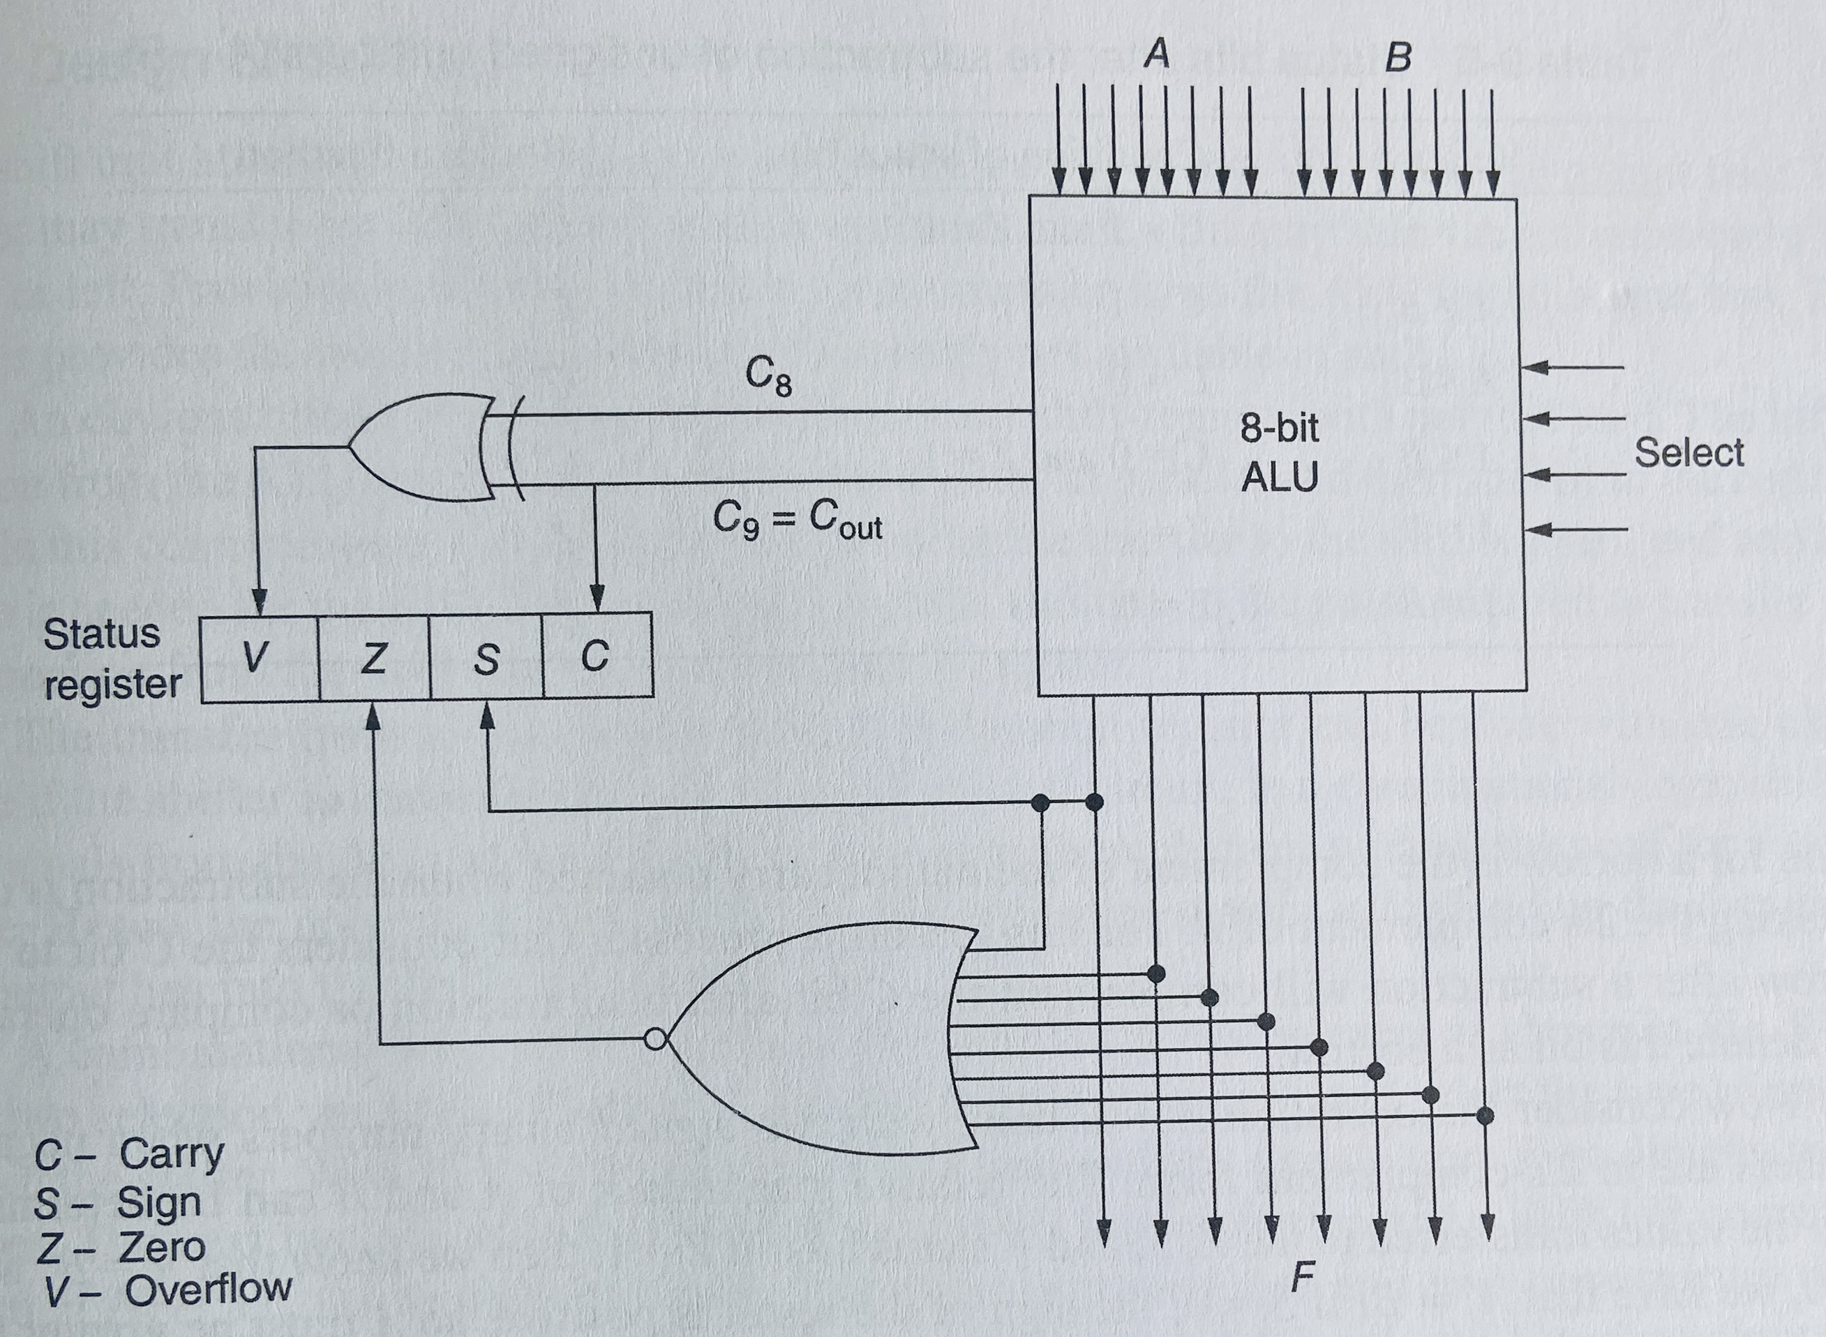
Status Register
The Status Register reflects the results obtained in the ALU.
They are stored in the status register for further analysis.
Following figure shows the 8-bit ALU with 4-bit Status Register ,where C is carry bit, S is sign bit Z is Zero bit and V is Overflow bit.

Slide 11
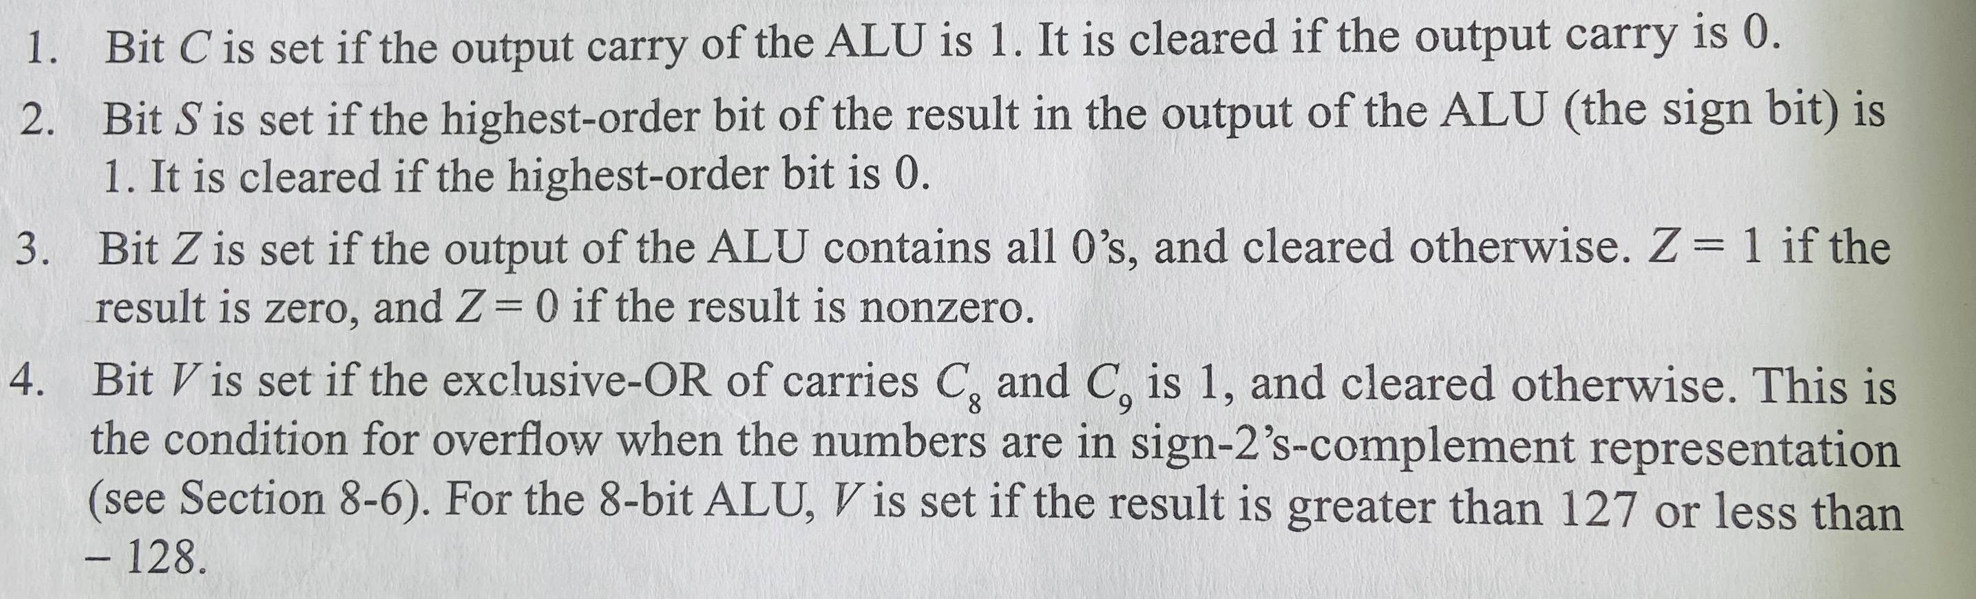
Working of Status Register

Slide 12
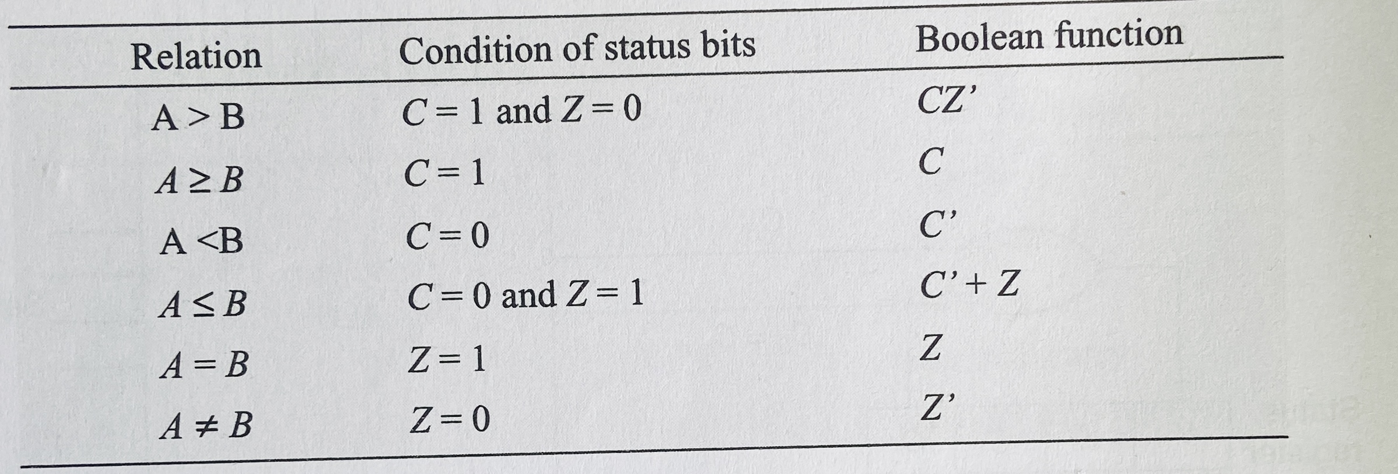
Functional Table of Status Register

Slide 13
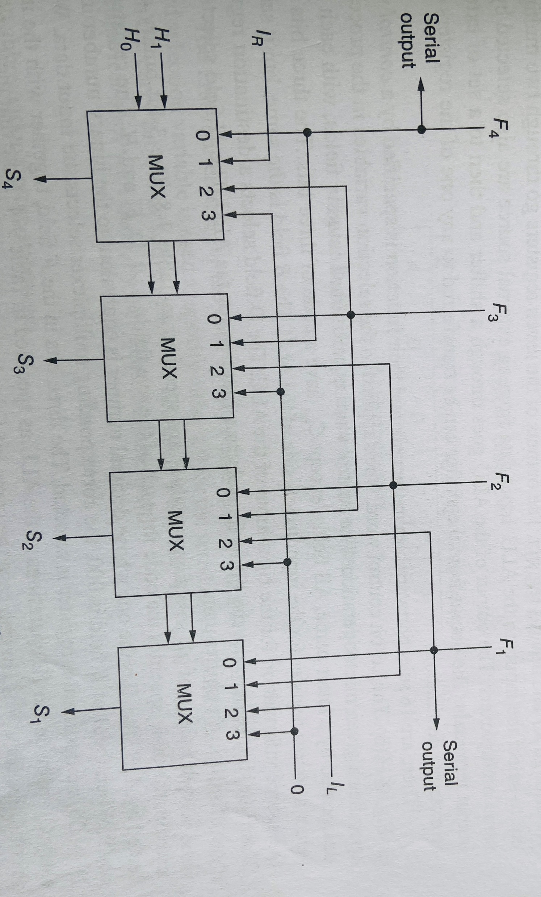
Shifter
The Shifter are the unit attached to a processor that transfers the output of the ALU to the output bus.
They shift the information without a shift or shifting the information right or left.
Following diagram shows the block diagram of the 4-bit Combinational –Logic Shifter

Slide 14
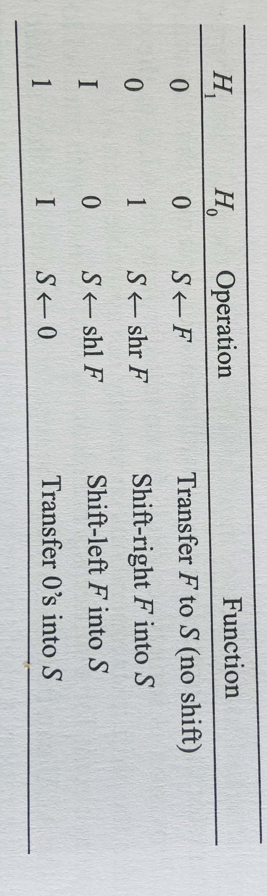
Working
A shifter is a bi directional shift register with the parallel load .
The information from the ALU is transferred to the register in parallel and then shifted to the right or left.
Here only one clock pulse is needed in the processor system for loading the data from the output bus into destination register.
A combinational logic shifter can be constructed with the multiplexer as shown above .
The Two select variable H1 and H0 , is applied to all four multiplexer and selects the type of operation in the shifter.
When H1H0 =00,no shift is executed and the signals from F go directly to the S lines.
When H1H0=1,the multiplexer selects the input attached to 0 and as a consequences the S outputs are also equal to 0,blocking the transfer of information from ALU to the output bus.
Here IL and IR serves as the serial inputs for the last and first stage during right or left shift.
Functional Table of Shifter

Slide 15
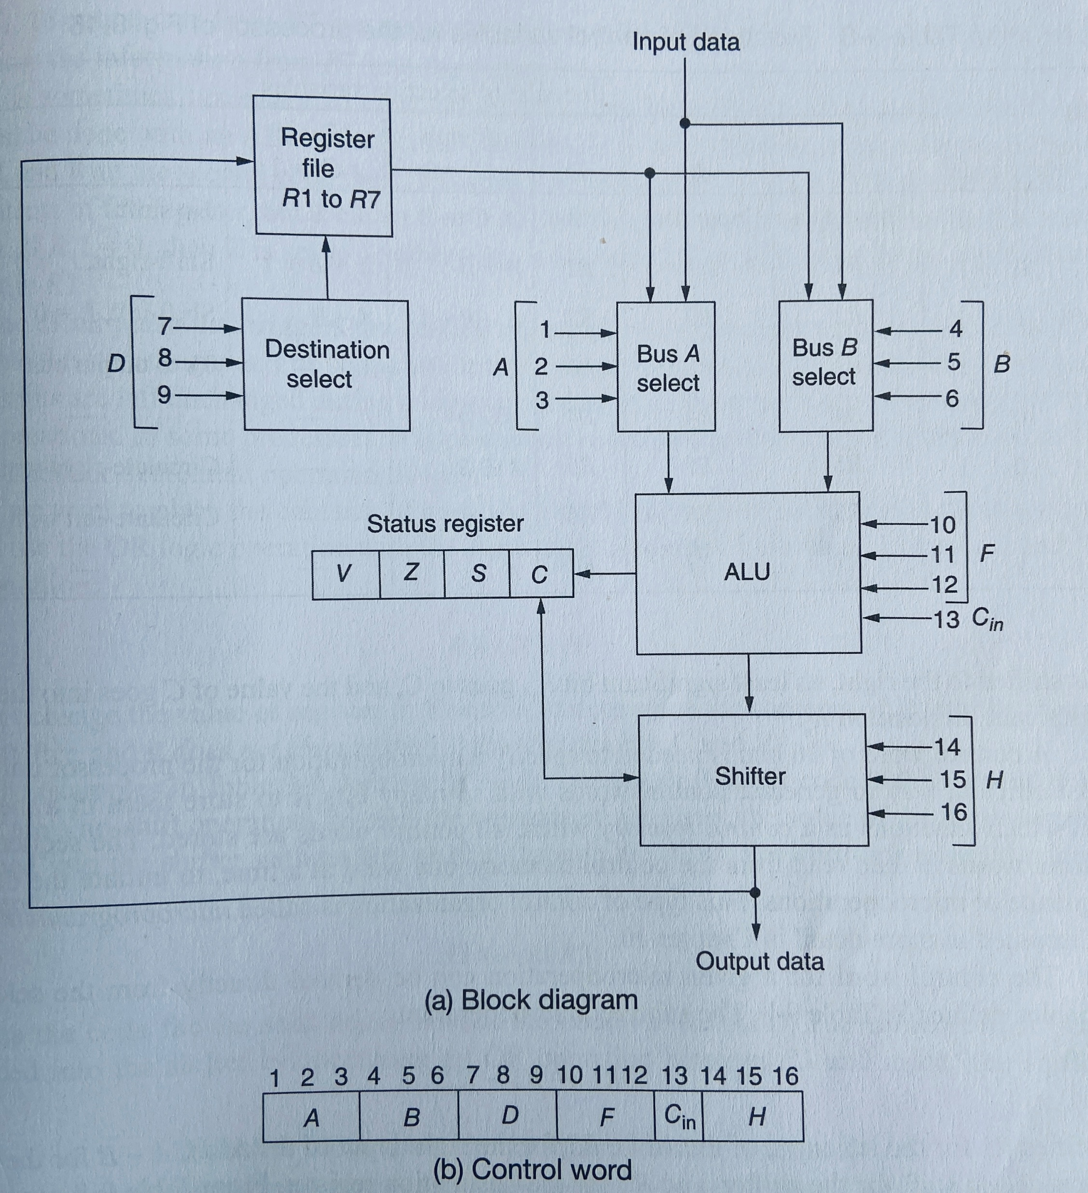
Processor Unit
Block Diagram of Processor Unit

Slide 16
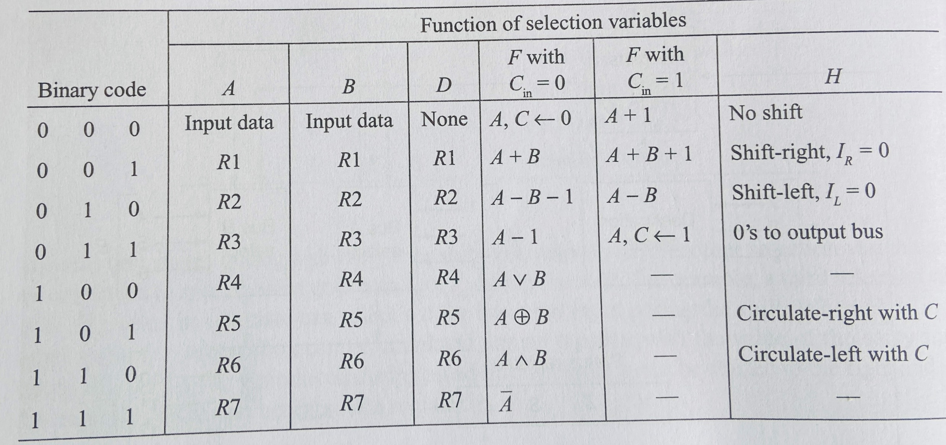
Functional Table of Processor Unit

Slide 17
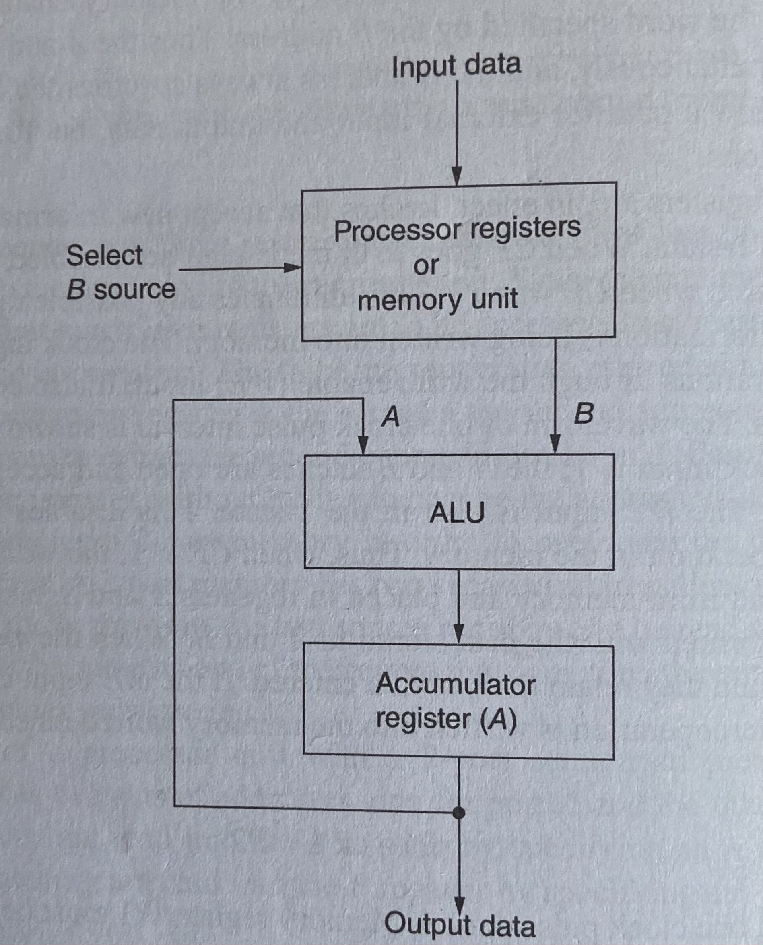
Accumulator Register

Slide 18
Accumulator Register
The accumulator register is another type of central processing unit register that is widely used for storing the logic or intermediate results. It is denoted or represented by “A” or “AC”
The accumulator register has a very important role as if it is not there then all the intermediate results need to be stored in the main memory that can increase the overhead on the memory.
It is because then unnecessary read and writes operations will be increased.
The accumulator register can easily store the intermediate results.
The accessing speed of the accumulator register is much faster compared to the main memory.
In many modern systems, there are various types of accumulators that can be used to store the intermediate results.
However, more the use of accumulators more complex will be the design.
For example, in the operation "3 + 4 + 5," the accumulator would hold the value 3, then the value 7, then the value 12.
The benefit of an accumulator is that it does not need to be explicitly referenced, which conserves data in the operation statement.
Microoperations at Accumulator Register:
A 0 i.e. A is cleared first
A A+R1 i.e. Transfer R1 to A
A A+R2 i.e. Add R2 to A

Slide 19
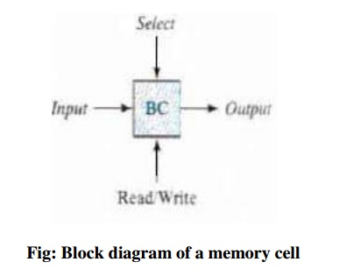
RAM
When the Read/Write Input value is 0 then the write mode is selected and when Read/Write Input value is 1 then Read mode is selected

Slide 20
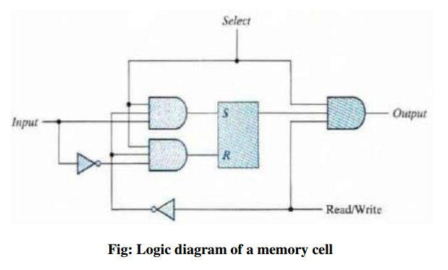
RAM

Slide 21
